Slide 1

Reporting From the WebFOCUS Repository
Utilities You Can Use Now
Barry Austin
Technical Account Manager

Slide 2
WebFOCUS 8 Repository Utilities
Today’s Topics
Reports for the WebFOCUS Administrator
Groups information
User information
Inventory of entire repository
Reports for any WebFOCUS role
Items changed since a specified date
String search (for repositories that are MS SQL Server or Oracle based)

Slide 3
WebFOCUS 8 Repository Utilities
Easy to setup and use
Setup overview
Download a package, unzip to app folder ‘repository’
Create WF synonyms (7 total)
(For split tier environments only) Relocate the menu web page
Setup instructions are provided in a document included in the package
Usage
http://hostname/approot/repository/menu.htm

Slide 4
WebFOCUS 8 Repository Utilities
Disclaimers
These repository utilities are not officially supported by IBI, nor myself
Highly likely that these will work in your environment, but no guarantees
You can use them ‘as delivered’, or as a foundation to change or add your own – however, if you pursue changing or adding, keep in mind that the internal organization and logic of the WebFOCUS repository is not publicly documented, and is subject to change from release to release
Tested with WebFOCUS 8.0 and 8.1 successfully
Not tested with 8.2

Slide 5
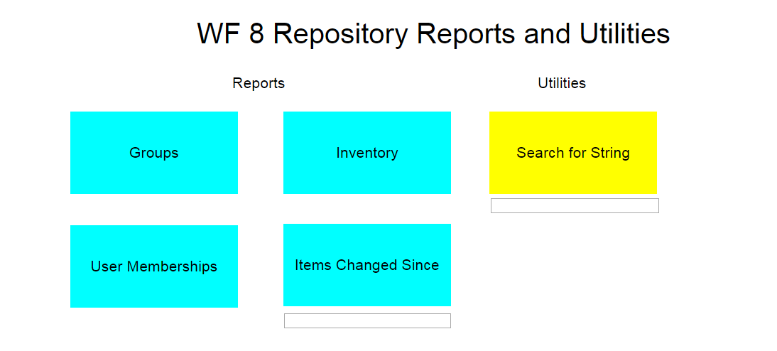

Slide 6
Groups and Users information

Slide 7
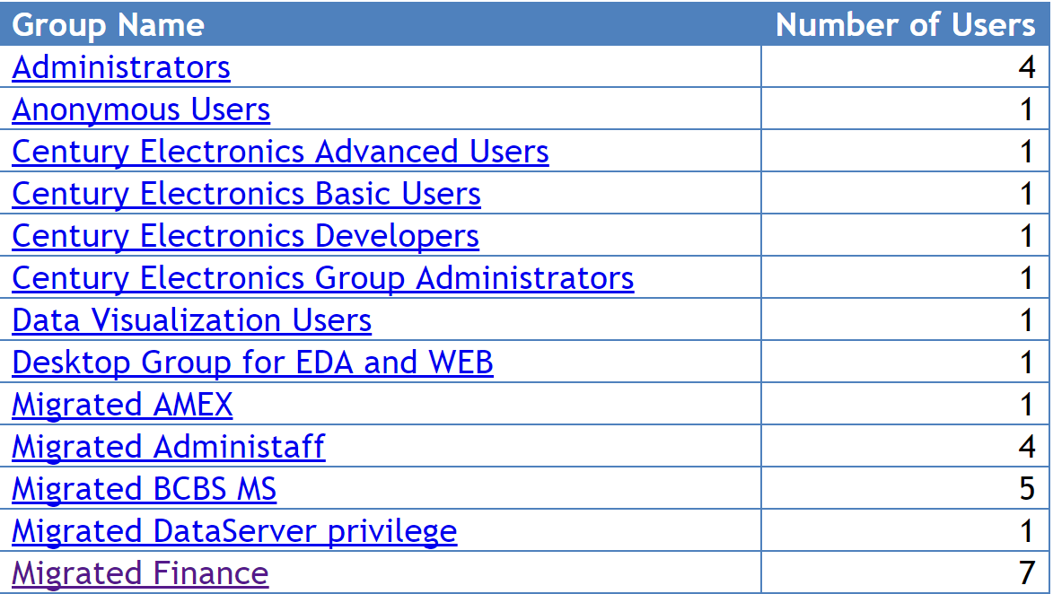

Slide 8
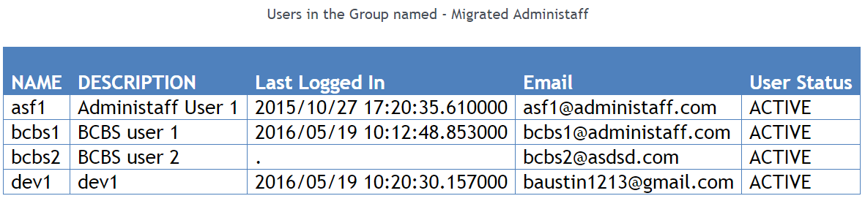

Slide 9
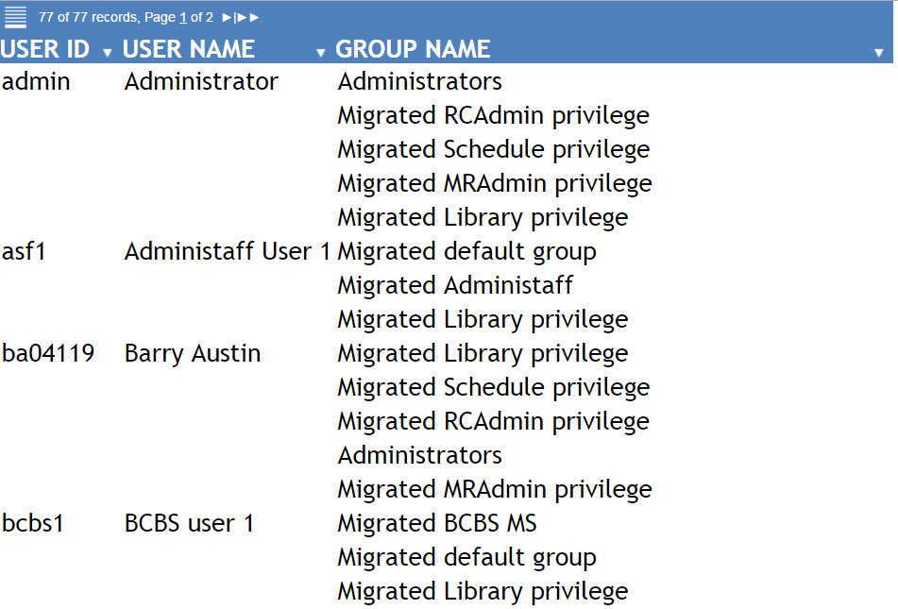

Slide 10
Inventory report

Slide 11
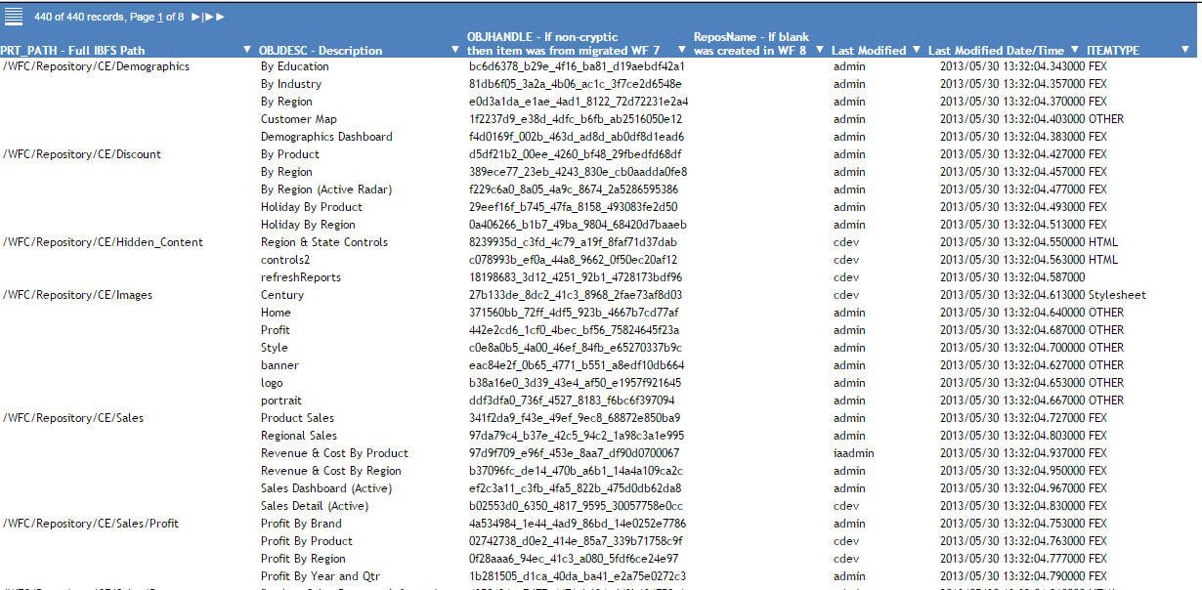

Slide 12
Items Changed Since report

Slide 13
WebFOCUS 8 Repository Utilities
Items Changed Since report
You specify a date (YYYYMMDD or YYYY/MM/DD)
Result is listing of all items that have been modified since that date
FEX’s
HTML
Image files
JS, CSS files
ReportCaster items (Schedules, Address books, Library items etc.)
Reporting Objects
Other items (URL’s, help files etc.)

Slide 14
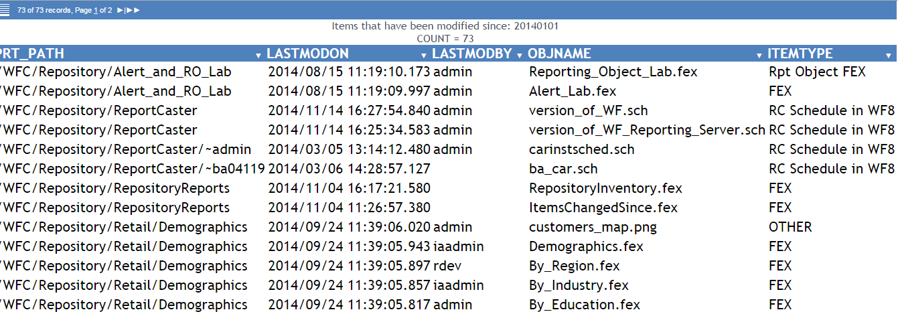

Slide 15
WebFOCUS 8 Repository Utilities
Items Changed Since report – Common Use Cases
Building Change Management Packages
You want to know what has been changed since a give date, perhaps so that you can know what items should belong to a Change Management Export scenario
Troubleshooting
Did someone modify an item in the repository that caused a recent failure?

Slide 16
Search report

Slide 17
WebFOCUS 8 Repository Utilities
Search report
You specify a text string (anything)
Result is listing of all items that contain the specified text string
FEX’s
HTML
Image files
JS, CSS files
ReportCaster items (Schedules, Address books, Library items etc.)
Reporting Objects
Other items (URL’s, help files etc.)

Slide 18
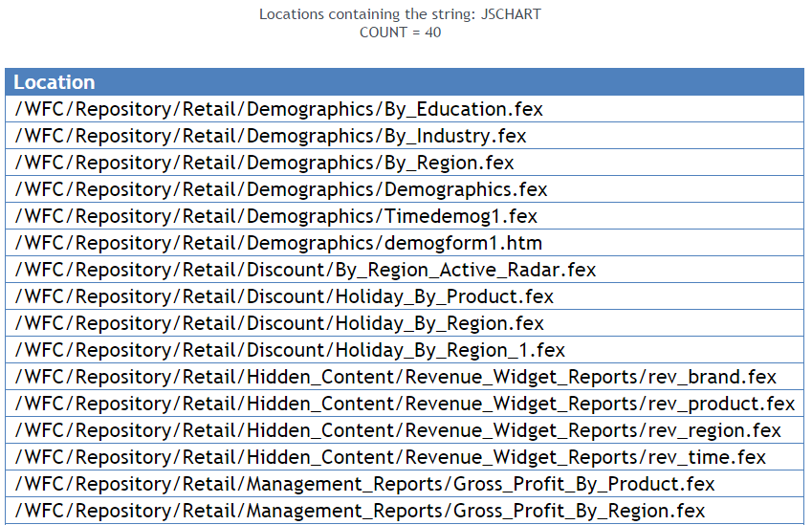

Slide 19
WebFOCUS 8 Repository Utilities
Search report – Common Use Cases
Hard coded names
Server names http://wf77prod/
\\wf77prod
Path names D:\ibi\apps
Field names REGION
GROSS_PROFIT
File names logo.gif
holdsummary.ftm

Slide 20
WebFOCUS 8 Repository Utilities
Search report – Common Use Cases
WebFOCUS specific syntax
Control language -SET &ECHO=ALL;
-SET &ECHO= ALL;
-SET &ECHO = ALL;
FILEDEF
Query/report language GRAPH FILE
TABLE FILE CAR
COMPUTE PROFIT=

Slide 21
WebFOCUS 8 Repository Utilities
Search report – Common Use Cases
Any string at all
A person’s name Barry Austin
A specific color name GREEN
A specific & variable name &YEAR
A specific keyword SET NODATA

Slide 22
Questions?

